Slide 1
Application of leadership theories
Learning outcome-
Students will be able to
1.Understand Leadership Styles
2.Analyse Leadership Theories
3. Application of leadership theories in various phases of GD Process

Slide 2
Activity
Name a leader of your choice.
Why the person is considered as a leader?
Identify his/her leadership traits.
Enlist the achievement of this leader.

Slide 3
Leadership
Leadership refers to the ability of one individual to influence others to change their behavior in order to achieve a shared goal.
The person influencing others (leader) possesses a set of qualities or characteristics with which he or she has to influence others.

Slide 4
DEFINITIONS
Leadership is the ability of a manager to induce subordinates (followers) to work with confidence and zeal.—Koontz and O’Donnell
Leadership is the ability to awaken in others the desire to follow a common objective.
—R. T. Livingston

Slide 5
Leadership traits
https://www.youtube.com/watch?v=laDWCgWDzyE

Slide 6
LEADERSHIP TRAITS
Sympathy
Nurturing and caring
Uprightness
Direction
Communication
Flexibility
Complexity Resolution
Strategic Action
Innovation

Slide 7
IMPORTANCE OF LEADERSHIP
Clarity and Communication
Motivation
Change Management
Planning
Employee Relations
Crisis Management

Slide 8
Leaders v/s Managers
Manager
An officially designated authority
Responsible for controlling and supervision of sub-ordinates
Provides instructions to his subordinates
Main focus is on achievement of employees
Leader
An authoritative individual
Responsible for building trust
Provides a vision to believe in and strategic alignment
Trains and guides people and empowers them.
Main focus is on growth and development of employees

Slide 9
……………
Avoids risks
Negotiates and coerces. Balances opposing views
Takes risks when opportunities appear promising
Develops fresh approaches for solving problems

Slide 10
LEADERSHIP STYLES
Autocratic Style (Do What I Say)
Leader decides and instructs the team and the subordinates follow him and implement his decisions.
Employees play no role in decision-making.
Adolf Hitler is an example of the autocratic leaders.

Slide 11
Participative Style (Let Us Work Together)
Consultative: In this style leaders takes opinions from the group members before coming to the final decision.
Consensual: These leaders believe in motivating the group members to discuss on the issue and then arrive at a conclusion.
Democratic: In this style, each group member votes before the leader takes any decision. Here the entire authority lies with the group.

Slide 12
Supportive leadership
Supportive leadership involves building trust, inspiration, and helping colleagues overcome the challenges they encounter.
Leaders looking to be more supportive of their teams should try to encourage teamwork, pay attention to members' relationships and also show commitment.

Slide 13
Free-rein style (I Go and You Work)
Leader gives entire freedom to the group members to identify the goals and objectives, take decisions, and resolve issues.
For example, free-rein style of leadership occurs in research and development sections of industry.

Slide 14
Entrepreneurship leadership style
A charismatic personality that inspires others to do business with him.
A much stronger interest in dealing with customers than employees.
A strong dislike for bureaucratic rules and regulations.

Slide 15
MCQ
Michael is a type of manager who is concerned primarily with making decisions and dictating the same to followers. His behavioral style is called:
a. autocratic. b. democratic. c. task oriented. d. people oriented.

Slide 16
quiz
When followers are given free hand in developing goals and deciding courses of action to achieve the same this is called-
A. Supportive style
B. Laissez Faire style
C. Autocratic style
D. Entrepreneurship style

Slide 17
Theories of leadership
Trait Theory
What characteristics or traits make a person a leader?
Trait theories of leadership sought personality, social, physical or intellectual traits that differentiate leaders from non leaders

Slide 18
Leadership Traits
Ambition and energy
The desire to lead
Honesty and integrity
Self-confidence
Intelligence
Job-relevant knowledge
Achievement drive
Leadership motivation
Discipline

Slide 19
……….
Vision & foresight
Acceptance of Responsibility
Open-Minded and adaptability
Human Relations Attitude
Fairness and Objectivity
Emotional maturity
https://www.youtube.com/watch?v=laDWCgWDzyE

Slide 20
Advantages and disadvantages
Advantages
It gives a yardstick for assessing the leadership traits of an individual.
It’s a valid theory as lots of research has validated its foundation.
Disadvantages
Subjective judgment is bound to happen

Slide 21
Behavioral Theory
In contrast with trait theory, behavioral theory attempts to describe leadership in terms of what leaders do, while trait theory seeks to explain leadership on the basis of what leaders are.
Leadership according to this approach is the result of effective role behavior.
Leadership is shown by a person’s acts more than by his traits.

Slide 22
……….
Behavioral theory proposes that specific behaviors differentiate leaders from non leaders on the basis of the following:
Pattern of actions used by different individuals determines leadership potential

Slide 23
Advantages of Behavioral Theory
Promotes participative decision making and team development.
Helps managers find the right balance between different styles of leadership.

Slide 24
Disadvantages
The approach only focuses on the surface of people's issues such as their behavior. It fails to look at underlying causes such as what occurs in the human mind.
Some describe the approach as being very narrow and deterministic. For example it assumes that all behavior is learned when in fact some peoples actions are a result of what they have experienced in the past

Slide 25
MANAGERIAL GRID THEORY (Blake and Mouton)
Managerial grid is a graphical representation of two behavioral dimensions of a leader:
❑ Concern for People (Y-axis): This is the extent to which a leader accommodates the needs and interests of the team members and gives them priority while making a decision about best means to accomplish a task.
❑ Concern for Production (X-axis): - This is the extent to which a leader lays emphasis on tight schedules and high productivity while making a decision about best means to accomplish a task.
❑ The scale of grid ranges from 1 (low) to 9 (high), thus forming 81 positions.

Slide 26
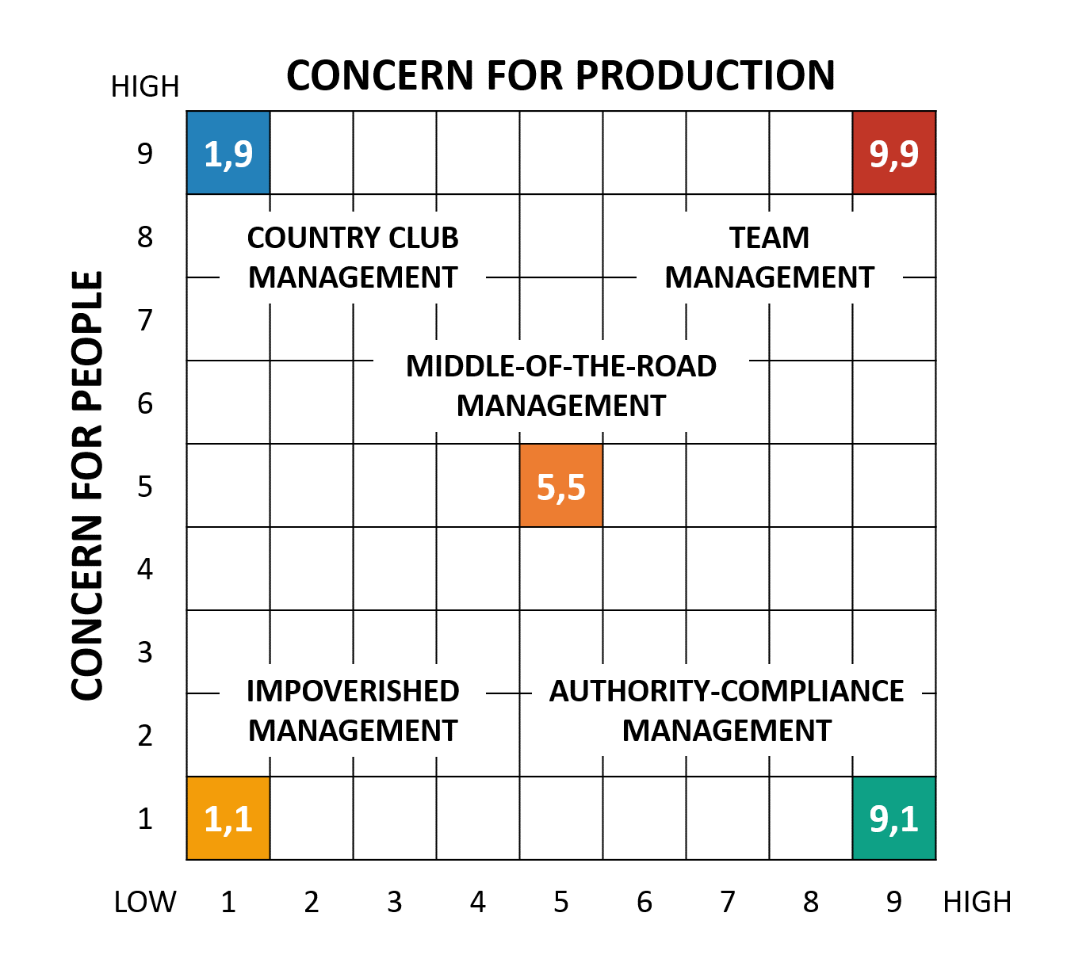

Slide 27
Advantages and disadvantages
Advantages:
Based on the information generated from the grid, leaders can decide the necessary changes to be made.
Disadvantages:
The model neglects the essence of internal and external limits which affects the working process

Slide 28
MCQs
What do you call a style of leadership that takes account of others' views, opinions and ideas?
a) Laissez-faire
b) Democratic
c) Autocratic
d) None of the above

Slide 29
2
A leadership style which empowers the followers to make decisions on their own is called as-
a) Free reign
b) Democratic
c) Autocratic
d) None of the above

Slide 30
Situational Leadership (Hersey and Blanchard )
Situational leadership theory depend upon a proper match between a leader's style and the maturity Levels of the members.
There are basically three steps in the model
1) Identifying Leadership Style
2) Defining the situation/maturity level
3) Matching leaders and situations

Slide 31
………..
Hersey and Blanchard suggested that there are four primary leadership styles:
Telling (S1): In this leadership style, the leader tells people what to do and how to do it
Selling (S2): Leaders "sell" their ideas and message to get group members to buy into the process.

Slide 32
………..
Participating (S3): In this approach, the leader offers less direction and allows members of the group to take a more active role in coming up with ideas and making decisions.
Delegating (S4): This style is characterized by a less involved, hands-off approach to leadership. Group members tend to make most of the decisions and take most of the responsibilities for what happens.

Slide 33
Four different levels of maturity
M1: Group members lack the knowledge, skills, and willingness to complete the task.
M2: Group members are willing and enthusiastic, but lack the ability.
M3: Group members have the skills and capability to complete the task, but are unwilling to take responsibility.
M4: Group members are highly skilled and willing to complete the task.

Slide 34
Matching leadership style with maturity level
Low Maturity (M1)—Telling (S1)
Medium Maturity (M2)—Selling (S2)
Medium Maturity (M3)—Participating (S3)
High Maturity (M4)—Delegating (S4)

Slide 35
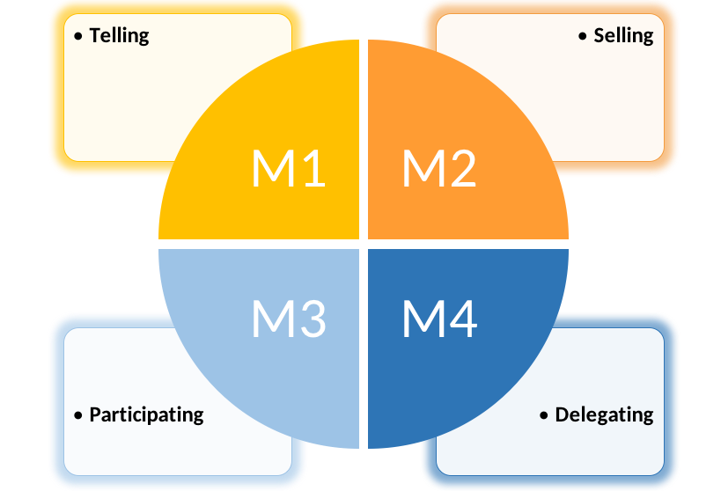

Slide 36
Quiz
What does situational theory of leadership emphasize?
a) Personality traits
b) Events
c) Environment
d) Political situation

Slide 37
1
Which of the following is an autocratic style of leadership? a) Directing style of leadership b) Consultative style of leadership c) Participative style of leadership d) Delegating style of leadership

Slide 38
2
The type of leadership style in which the leader seeks input from those working under him/her is called _________ a) Indirect style of leadership b) Consultative style of leadership c) Direct style of leadership d) Delegating style of leadership

Slide 39
3
In consultative style of leadership, the _______ is the final decision maker. a) Leader b) Workforce c) Founder d) Co-founder

Slide 40
4
In which of the following kind of leadership style the individual or team is given responsibility and authority to complete the task with minimum input from the leader?
a) Directing style of leadership b) Consultative style of leadership c) Participative style of leadership d) Delegating style of leadership

Slide 41
5
Which of the following is not a kind of leadership skill required for effective leadership? a) Vision b) Empowerment c) Intuition d) Threat

Slide 42
6
_______ occurs when leaders integrate their values into the company’s system. a) Intuition b) Self – understanding c) Value congruence d) Vision

Slide 43
7
Country club style of leadership is considered as a style which is ---
Production oriented
People oriented
Organization oriented
None of the above

Slide 44
8
__________ are the approaches to the study of leadership which emphasise the personality of the leader: A. Contingency theories B. Group theories C. Trait theories D. Inspirational theories

Slide 45
9
_________ used the terms “employee-centred” and “production-centred” to describe leader behaviour: A. Blake and Mouton B. Fiedler C. McGregor D. Likert

Slide 46
10
Leaders with a low LPC score gain satisfaction from _______________ according to Fiedler’s LPC scale: A. Developing team relationships B. Achieving objectives C. Both of these D. None of the above

Slide 47
11
A leader exercises his power over his followers because of his position held in the. organizational hierarchy is ____. A. autocratic leader. B. intellectual leader. C. liberal leader. D. institutional leader.

Slide 48
12
The leader who excels as a leader because of his superior knowledge is ___-. A. autocratic leader. B. intellectual leader. C. liberal leader. D. institutional leader.

Slide 49
13
A leader who serves as the head of the family and treats his followers like his family members is ____. A. paternalistic leader. B. intellectual leader. C. liberal leader. D. institutional leader

Slide 50
14
__________ are the approaches to the study of leadership which emphasize the personality of the leader: A. Contingency theories B. Group theories C. Trait theories D. Inspirational theories

Slide 51
15
Contingency theories of leadership based upon: A. That there is no single style of leadership appropriate to all situations B. That there is a single style of leadership appropriate to all managers C. That there is a single style of leadership appropriate to all situations D. None of the above

Slide 52
16
What are the key characteristics of transactional leaders?
a) Guiding, mentoring and motivating
b) Guiding, commanding and motivating
c) Guiding, demonstrating and motivating
d) Guiding, mentoring and demonstrating

Slide 53
17
What is the term for power derived from status or position in an organization?
a) Referent
b) Expert
c) Reward
d) Legitimate

Slide 54
18
According to Lewin, Lippet and White's 1939 experiment, which form of leadership produced the most work from participants?
a) Laissez-faire
b) Democratic
c) Authoritarian
d) A mix of laissez-faire and democratic

Slide 55
19
Leadership today is increasingly associated with the concept of ______________?
Control
Command
Getting others to follow
Strategy

Slide 56
20
Which of the following statements about leadership is false?
Not every leader is a manager
When people operate as leaders their role is always clearly established and defined
Leadership does not necessarily take place within a hierarchical structure of an organization
None of the above

Slide 57
21
In Adair’s approach, needs such as training the group, setting standards and maintaining discipline, and appointing sub-leaders may be called _____________.
Individual functions
Work functions
Team functions
Task functions

Slide 58
22
The Ohio State Leadership Studies revealed two major dimensions of leadership behavior: _________________ and initiating structure.
Communication
Collaboration
Consideration
Control

Slide 59
23
According to Fiedler’s LPC scale what will leaders with a low LPC score gain satisfaction from?
Achieving objectives
Developing team relationships
Building external connection
None of the above

